Slide 1
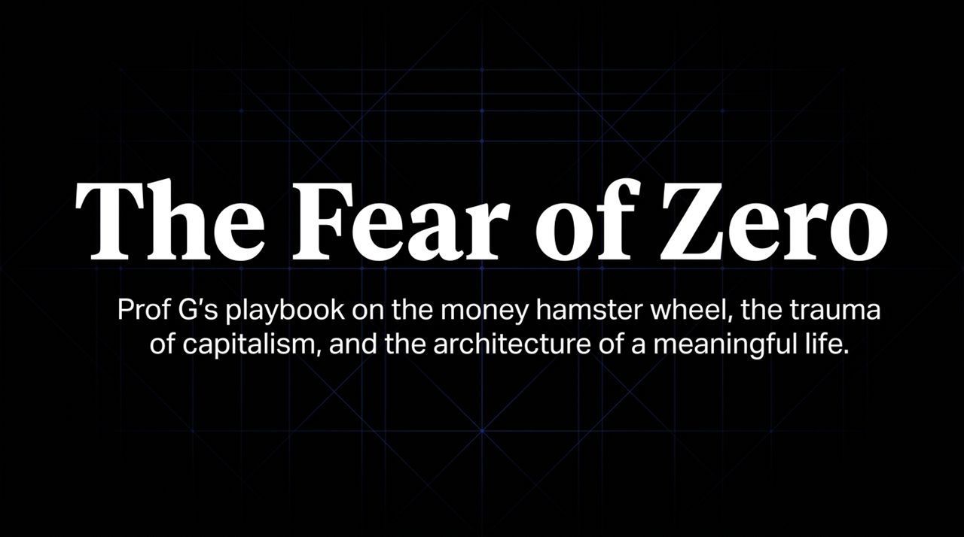
Notes:
Opening hook: Welcome everyone. Today we are diving into "The Fear of Zero"—a deep look at the psychology of wealth, the trauma of capitalism, and the architecture of a meaningful life, based on the insights of Scott Galloway.
Core Theme: Most financial advice focuses strictly on mechanics: how to invest, grow, and scale net worth. But we rarely address the emotional dysmorphia and trauma attached to money.
Setting the Stage: Scott Galloway, a successful multi-millionaire, entrepreneur, and NYU Stern professor, admits that despite his financial success, he is still driven by a visceral fear of going broke.
Key takeaway to prime the audience: Money isn't just about utility or buying power; it acts as an emotional armor against humiliation, a scorekeeper, and an existential safety net.
https://www.youtube.com/watch?v=-1kxqAbsDI8

Slide 2
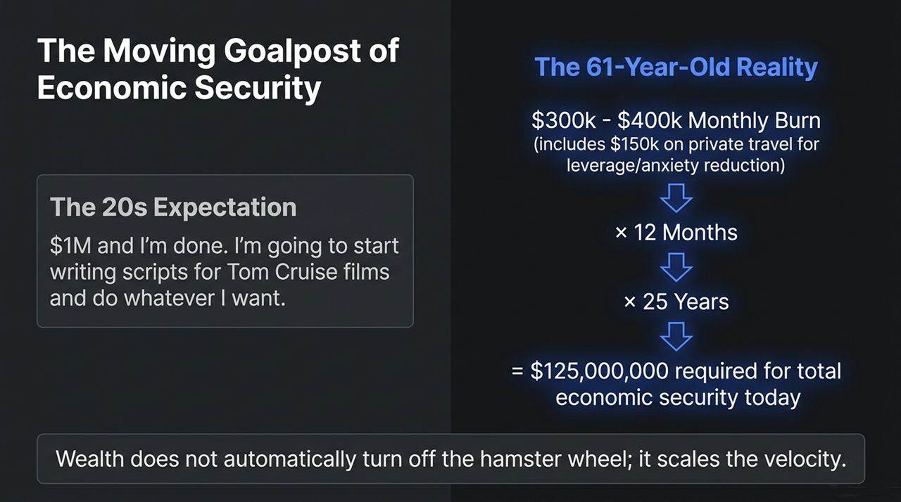
Notes:
Context: Highlight the contrast between young expectations and mature realities.
The 20s Expectation: In your 20s, a million dollars sounds like "i'm done" money. Galloway notes that in his youth, he thought saving $1M meant he could retire and write screenplays for Tom Cruise.
The 61-Year-Old Reality: Today, Galloway runs a monthly burn rate of $300,000 to $400,000, which includes $150,000/month spent on private aviation.
The 25x Math: Applying the standard 25x safe withdrawal rule (5% yield/withdrawal rate) on $5M annual burn yields an economic security threshold of $125 Million.
Speaker Commentary: Wealth does not automatically turn off the hamster wheel; it scales the velocity. Lifestyle inflation and high leverage to reduce personal anxiety expand the "enough" number continuously.

Slide 3
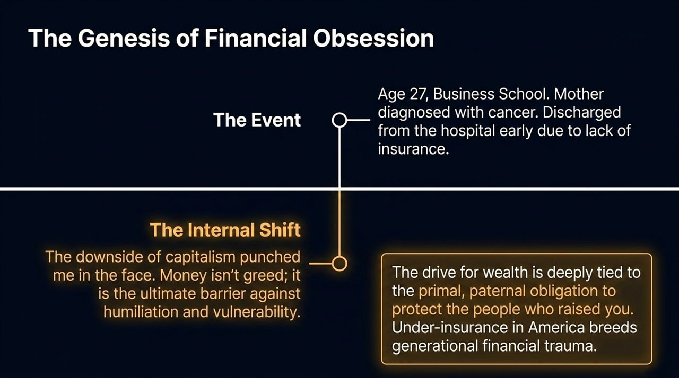
Notes:
Addiction 1: Affirmation of Others
Evolutionary Root: Up until recent history, being shamed and expelled from the tribe meant starving or dying within days.
Modern Symptom: Posting content at age 61 online hoping strangers will validate you.
Addiction 2: Money & Enterprise Value
Evolutionary Root: Resource hoarding for survival.
Modern Symptom: The paternal instinct to build safety nets for employees, combined with an inherent compulsion to accumulate more scorekeeping capital.
Speaker Commentary: High performance is often powered by dysfunctions that are evolutionary instincts operating in overdrive.

Slide 4
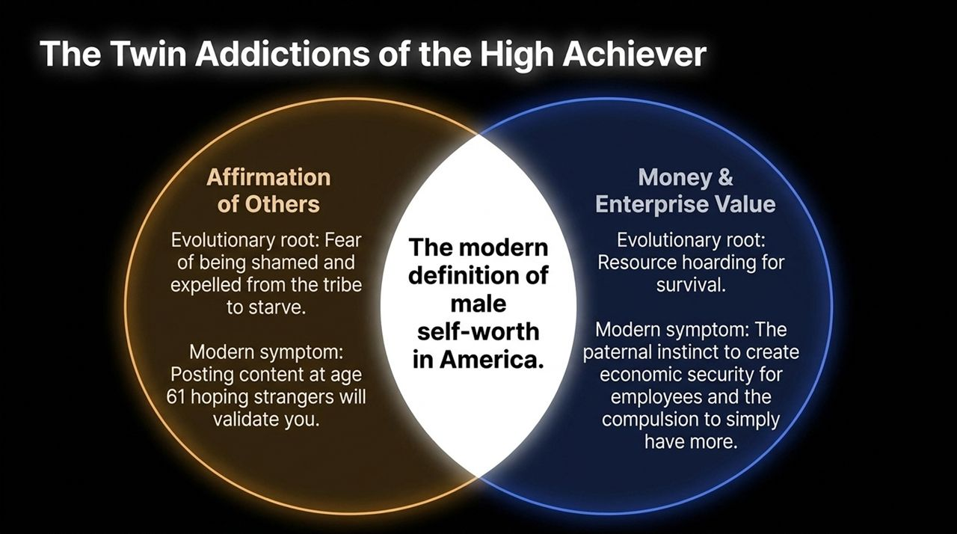
Notes:
Addiction 1: Affirmation of Others
Evolutionary Root: Up until recent history, being shamed and expelled from the tribe meant starving or dying within days.
Modern Symptom: Posting content at age 61 online hoping strangers will validate you.
Addiction 2: Money & Enterprise Value
Evolutionary Root: Resource hoarding for survival.
Modern Symptom: The paternal instinct to build safety nets for employees, combined with an inherent compulsion to accumulate more scorekeeping capital.
Speaker Commentary: High performance is often powered by dysfunctions that are evolutionary instincts operating in overdrive.

Slide 5
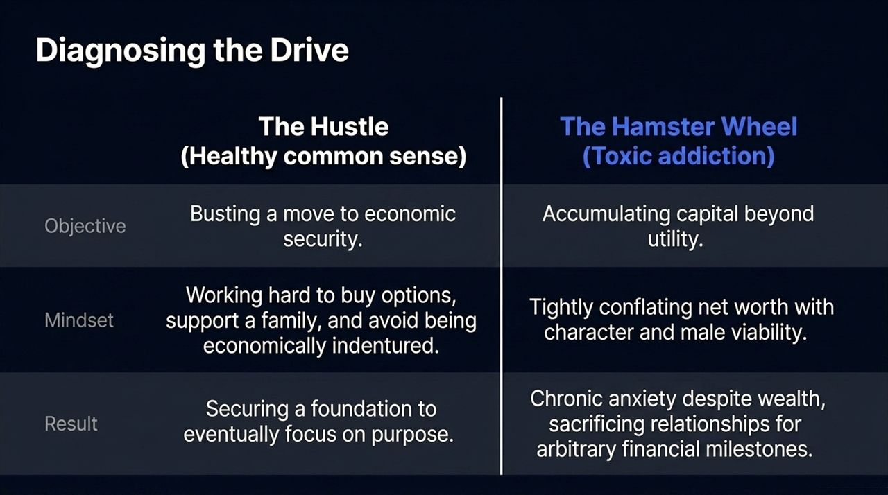
Notes:
The Hustle (Healthy Common Sense): For young people, grinding to achieve economic security isn't money addiction—it's basic survival and practical wisdom in a capitalist society. It buys freedom and options.
The Hamster Wheel (Toxic Addiction): Continuing to obsess over money long past utility, where net worth becomes tightly coupled with male identity and self-esteem.
Key Delineation: Early career hustle builds the foundation to eventually pursue purpose; staying on the hamster wheel long after achieving wealth yields chronic anxiety despite high net worth.

Slide 6
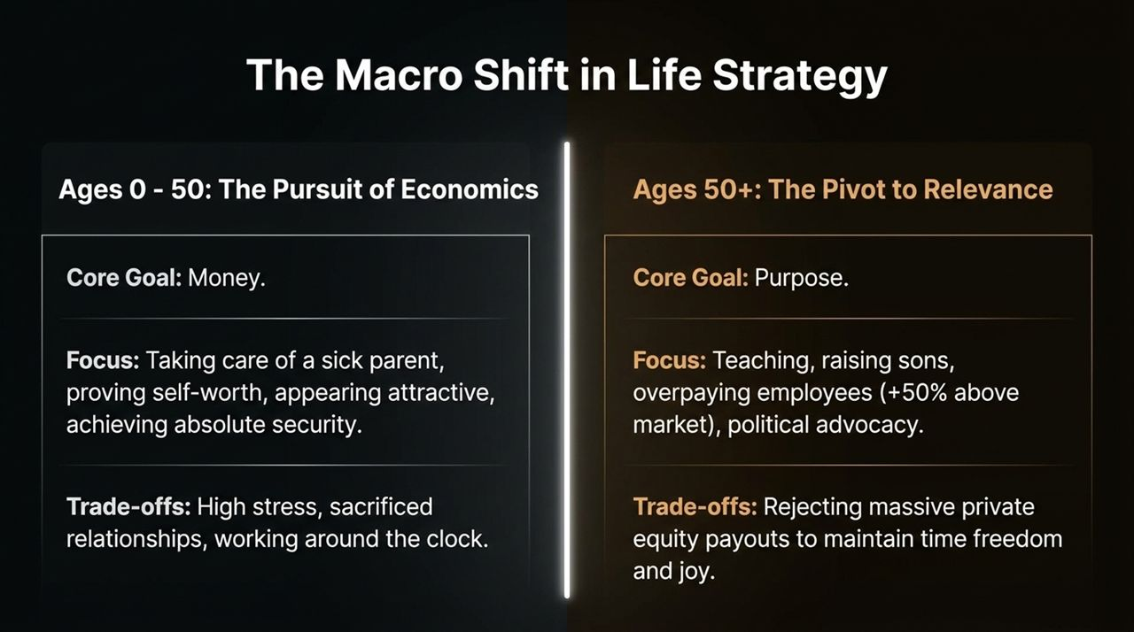
Notes:
Ages 0 – 50 (The Pursuit of Economics): Goal was strictly financial accumulation—taking care of a sick parent, proving worth, and securing safety. Sacrificed health, hair, and relationships to get there.
Ages 50+ (The Pivot to Relevance): Goal shifts from money to impact, purpose, and legacy.
Real-world example: Galloway turned down multi-hundred-billion-dollar private equity funds offering massive payouts because the incremental gain wasn't worth trading away his joy, time freedom, and teaching.

Slide 7
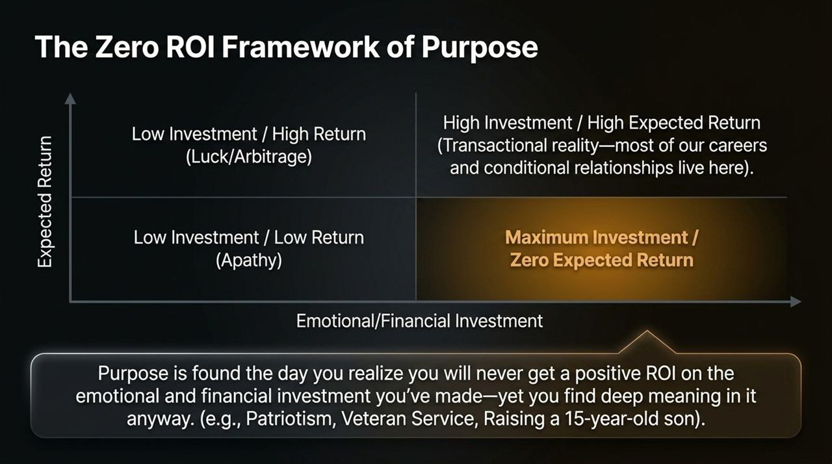
Notes:
Understanding the Matrix: Most career activities sit in the high investment / high expected return quadrant (transactional).
The Definition of Purpose: True purpose is discovered the day you realize you will never get a positive ROI on your emotional, financial, or psychological investment—yet you find deep meaning in it anyway.
Examples: Veterans serving their country, or raising a teenage son who will never repay the 2 AM worry or financial expenditure.

Slide 8
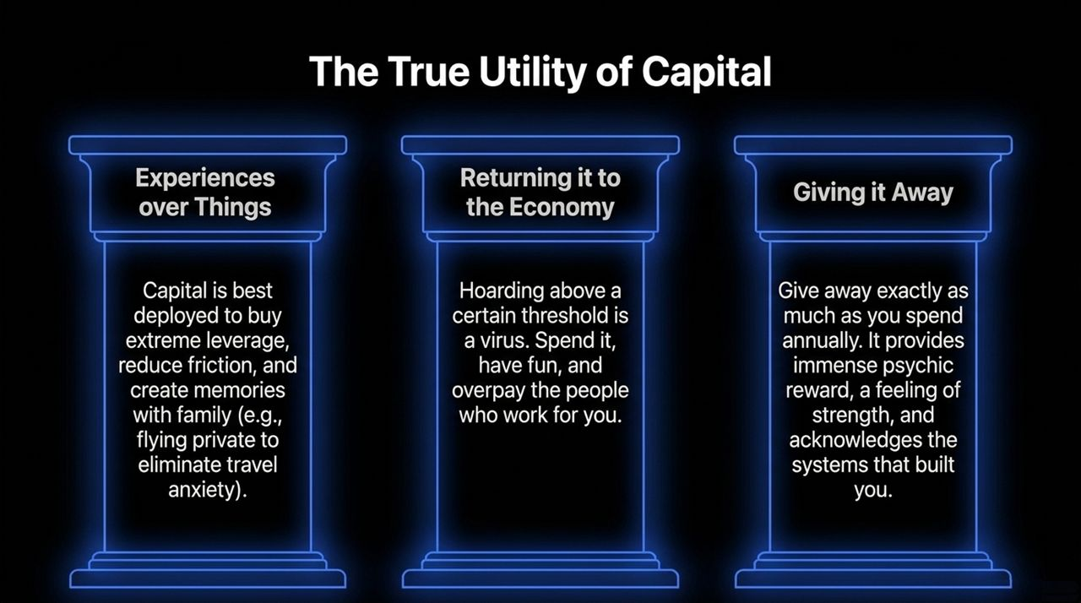
Notes:
1. Buying Experiences over Things: Spending on experiences yields lasting joy, while physical items decay in satisfaction.
2. Returning Capital to the Economy: Hoarding wealth above utility is a virus. Overpaying employees (e.g., +50% market rates) and spending puts capital back to work.
3. Giving It Away: Matching annual spending with equivalent charitable giving provides psychic reward and acknowledges the societal systems that made success possible.

Slide 9
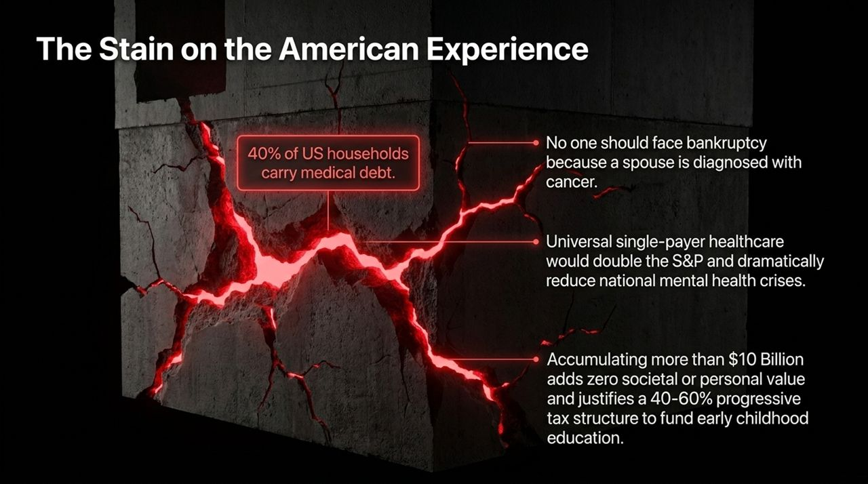
Notes:
Systemic Critique: 40% of U.S. households carry medical debt. No family should face bankruptcy because of a illness diagnosis.
Economic Policy Proposals: Universal single-payer healthcare would eliminate massive societal friction and boost national productivity and the S&P.
Taxation: Amassing over $10 Billion adds zero societal value; a 40-60% progressive tax structure should fund early childhood education and basic safety nets.

Slide 10
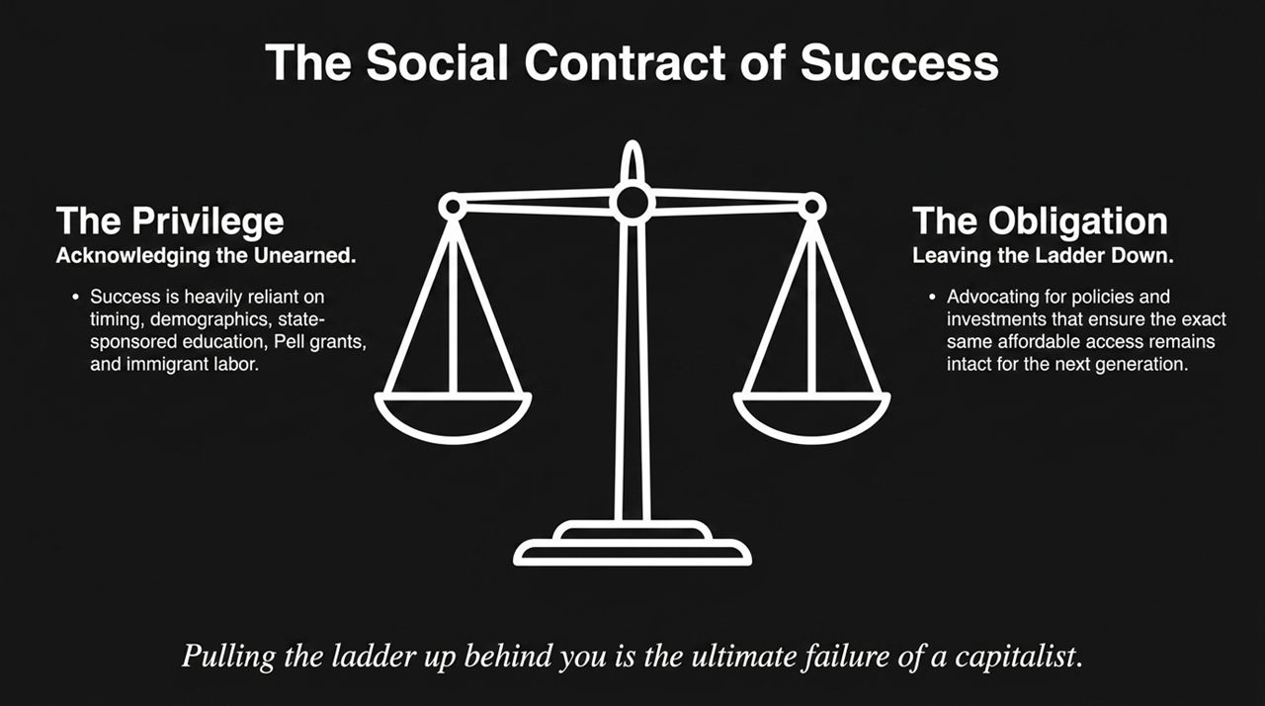
Notes:
The Privilege: Success is built on public infrastructure—Pell grants, state-sponsored universities, immigrant labor, and historical timing.
The Obligation: Winners in capitalism must leave the ladder down rather than pulling it up behind them. Advocating for public policy that supports the next generation is a fundamental duty.

Slide 11
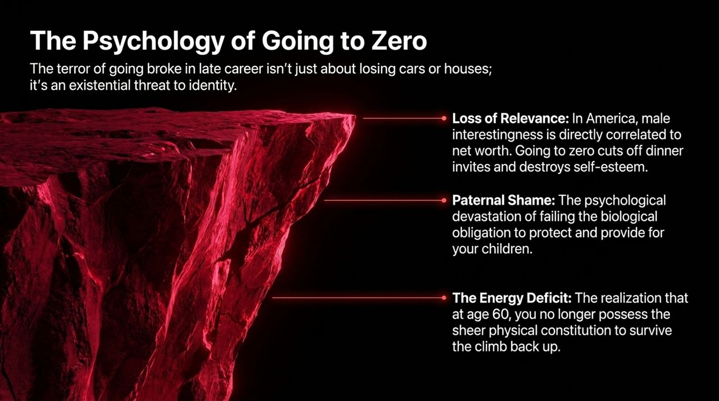
Notes:
Existential Identity Threat: Going broke in late career isn't just about losing comfort; it destroys self-worth.
Loss of Relevance: Male interestingness in American culture is heavily tied to net worth. Going to zero cuts off access and social validation.
Paternal Shame: The gut-wrenching feeling of failing to protect and provide for family.
The Energy Deficit: Realizing that at age 60+, you no longer possess the physical constitution to endure the climb back up.

Slide 12
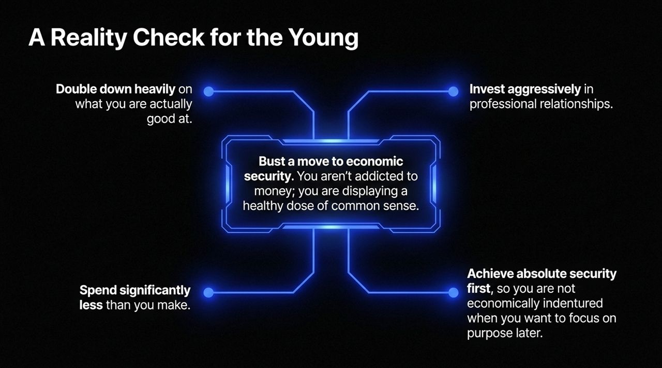
Notes:
Advice for Young Professionals:
Double down on strengths rather than chasing vague passions.
Live well below your means to build capital reserve.
Treat early career wealth building as common sense, not money addiction.
Build economic security so you are never economically indentured to a boss or partner.

Slide 13
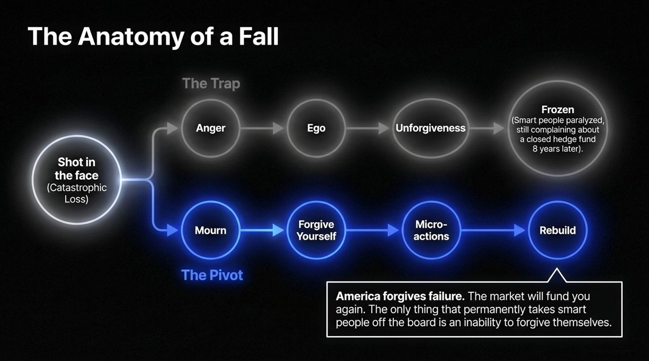
Notes:
The Catastrophic Event: Experiencing severe financial loss.
The Trap: Ego $→$Anger $→$Unforgiveness $→$Becoming frozen. Highly intelligent people remain paralyzed years later complaining about a failed venture.
The Pivot: Mourn $→$Forgive Yourself $→$Micro-actions $→$Rebuild.
Takeaway: Markets forgive failure, but you must overcome self-blame to re-enter the game.

Slide 14
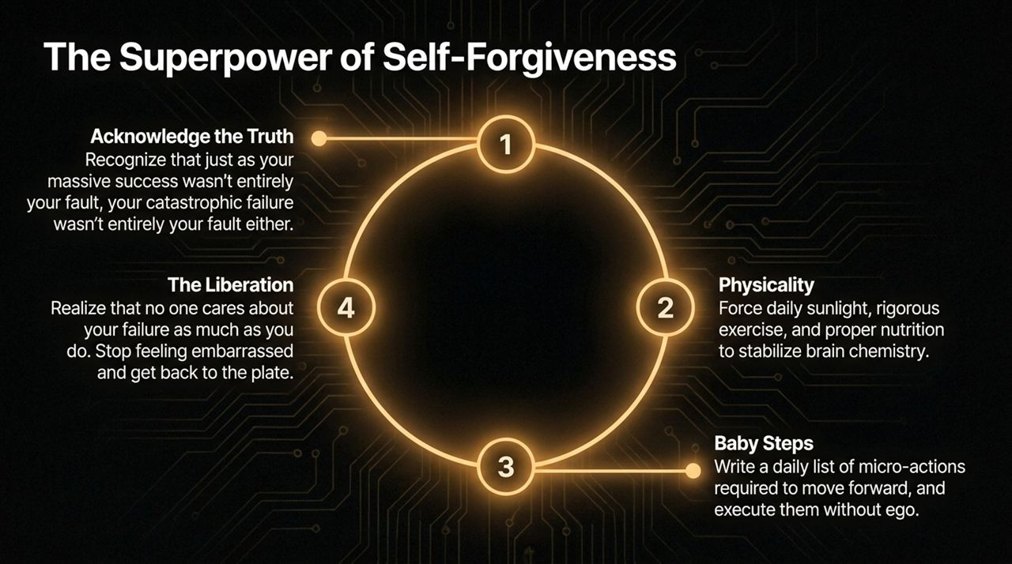
Notes:
1. Acknowledge Truth: Upside luck boosted your success; market turns caused your failure. Neither define your core worth.
2. Physicality: Force sunlight, exercise, and proper nutrition to regulate brain chemistry during trauma.
3. Execution: Write down daily micro-actions and complete them without ego.
4. Liberation: No one cares about your failure as much as you do—stop being embarrassed and get back to the plate.

Slide 15
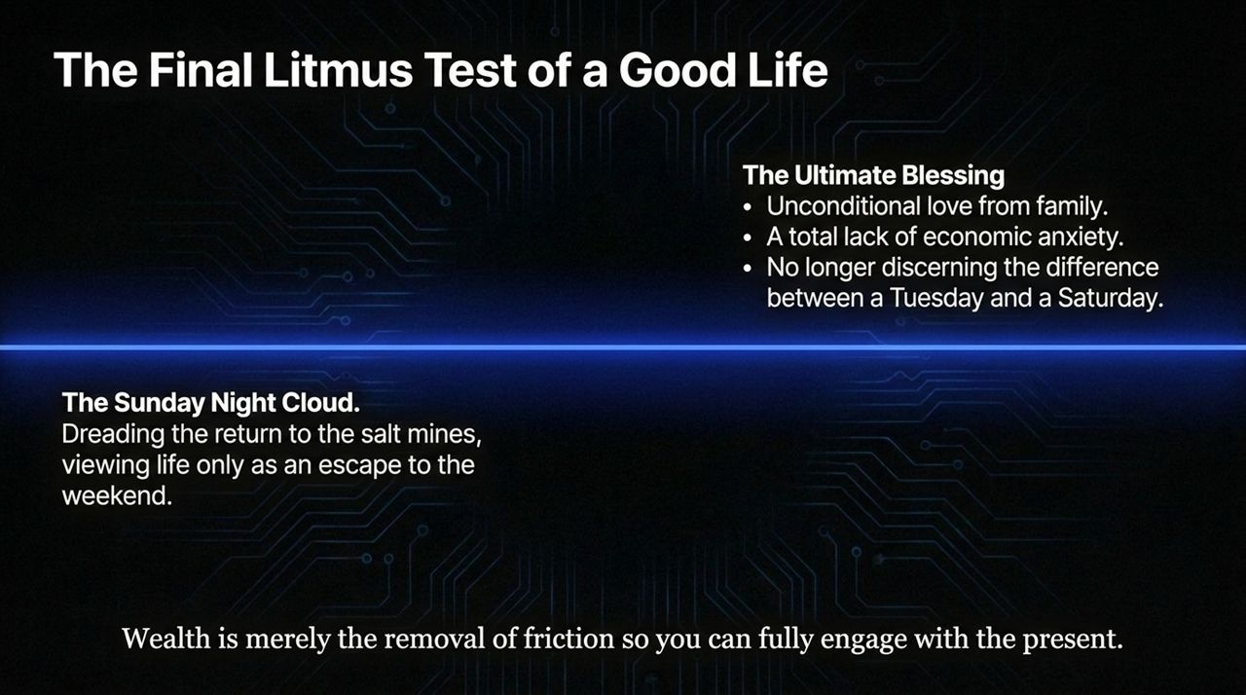
Notes:
The Sunday Night Cloud: Living for the weekend while dreading Monday morning is a sign of economic indenture.
The Ultimate Blessing:
Unconditional love from family.
Complete removal of financial anxiety.
No longer discerning the difference between a Tuesday and a Saturday.

Slide 16
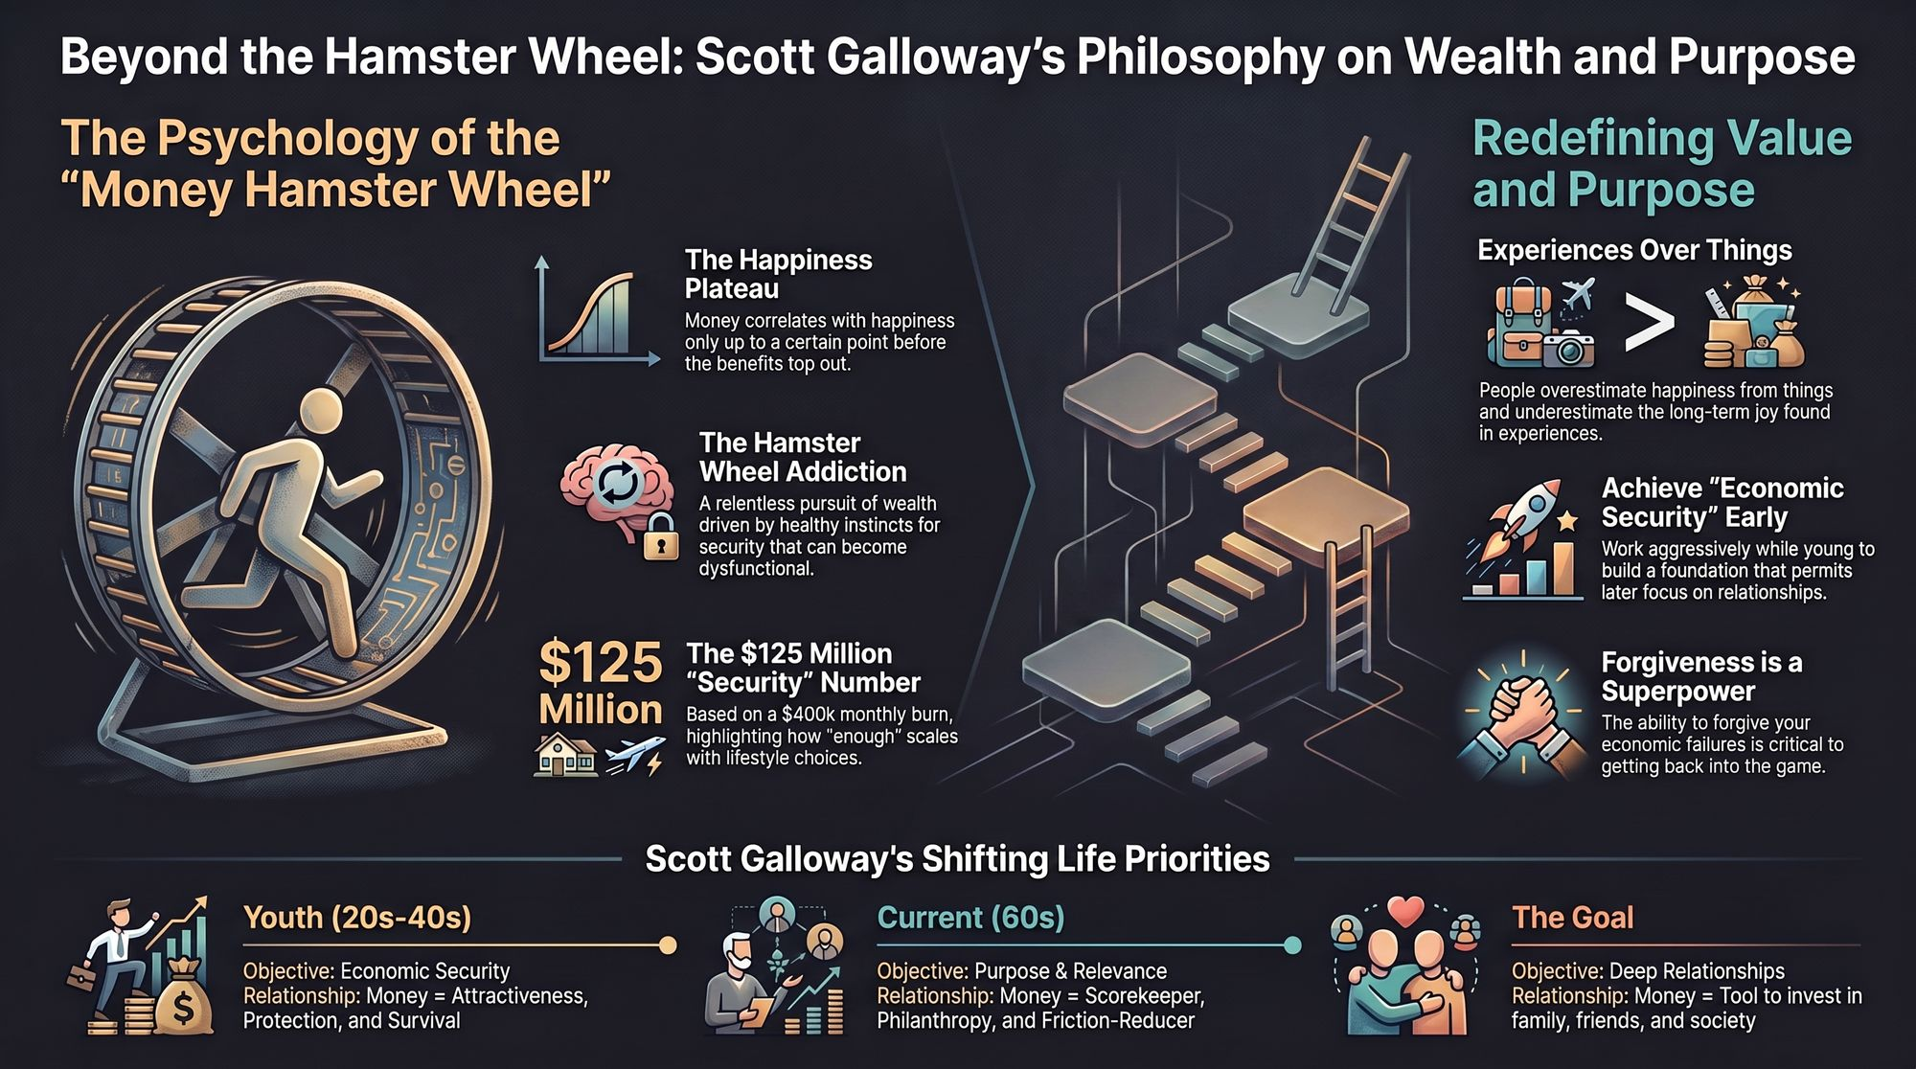
Notes:
Closing synthesis:
Happiness Plateau: Money matters immensely up to security, then marginal utility flattens.
Evolution of Priorities: Youth focuses on protection and survival; maturity pivots to relationships, purpose, and philanthropy.
Final Message: Use capital as a tool to remove friction and buy time so you can engage fully in what truly matters.

